Slide 1
Reformist approaches to Welfare

Slide 2
Reforms: improve something by removing faults

Slide 3
Per Capita Income
Norway
$100,000 (1,35,00,000, i.e. 11 lac 25 hazar PKR monthly)
Afghanistan
$619 (83,565 PKR, i.e. almost 07 hazar monthly)
Pakistan
$1300 (175,500PKR, i.e. 14625 monthly)

Slide 4
Children out of School (per 1000)

Slide 5
Pupil Teacher Ration (High School)

Slide 6
Infant Mortality Rate (1000)

Slide 7
Life Expectancy at Birth

Slide 8
Population below Poverty Line

Slide 9
Why is there so much variation in countries?
Income
Health
Life expectancy
Schooling
etc

Slide 10
DEVELOPMENT:
change and growth
the process of changing and becoming larger, stronger, or more impressive, successful, or advanced
Growth: get bigger: to become larger

Slide 11
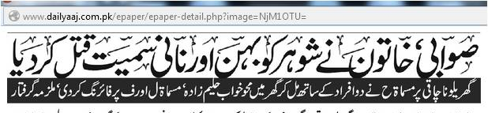
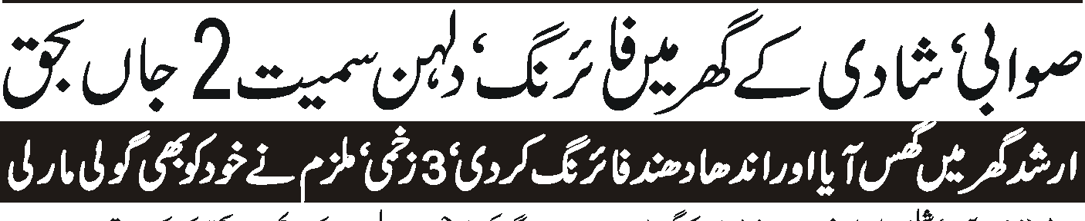
Problems of Development
Drug abuse
Family breakdown
Unemployment

Slide 12
What is the solution?
Revolution
Reform

Slide 13
Reformism is a political doctrine advocating the reform of an existing system or institution instead of its abolition and replacement.
Reformism is the view that gradual changes through existing institutions can eventually lead to fundamental changes in a society’s political and economic systems.
Reformism as a political tendency and hypothesis of social change grew out of opposition to revolutionary socialism,
Socialism contends that revolutionary upheaval is a necessary precondition for the structural changes necessary to transform a capitalist system to socialist economic system.

Slide 14
Welfare reforms are changes in the operation of a given welfare system.
The development of welfare in this approach is largely seen as a consequence of economic development of the society on the one hand and the acceptance of the moral responsibility of maintaining minimum standard of welfare on the part of the state on the other[1].
* [1] H.Y Siddiqui, (ed) 1990. Social Welfare in India. New Delhi: Harnam Publications . pp.4-5.
Notes:
This approach is not the thinking of one man or person rather an extract from the works of a number of English intellectuals including politicians, academicians, reformist and social researchers.
it simply advocates collecting data about relevant social maladies and debating various policy options within the given resource constraints to deal with them as effectively as possible.

Slide 15
This approach has a national focus whereby problems and policies of a particular society are analyzed in the context of specific concerns of welfare… the democratic state is expected to assume the responsibility of institutionalizing welfare rather than treating it as residual*…
Examples: BISP, Ghurbat Mukao Programme, Pakistan Poverty Alleviation Fund, PM Five Point Programme,

